Slide 1
Medical Statistics with R
Dr. Gulser Caliskan
Prof. Giuseppe Verlato
Unit of Epidemiology and Medical Statistics
Department of Diagnostics and Public Health
University of Verona, Italy

Slide 2
Power analysis is an important aspect of experimental design. It allows us to determine the sample size required to detect an effect of a given size with a given degree of confidence.
Conversely, it allows us to determine the probability of detecting an effect of a given size with a given level of confidence, under sample size constraints. If the probability is unacceptably low, we would be wise to alter or abandon the experiment.

Slide 3
The following four quantities have an intimate relationship:
Sample Size
Effect Size
Significance Level = P(Type I Error) = Probability of finding an effect that is not there
Power = 1 - P(Type II Error) = Probability of finding an effect that is there
Given any three, we can determine the fourth.

Slide 4
Sample Size
In designing an experiment, a key question is: How many animals/subjects do I need for my experiment?
Too small of a sample size can under detect the effect of interest in your experiment
Too large of a sample size may lead to unnecessary wasting of resources and animals
Goal: We strive to have enough samples to reasonably detect an effect if it really is there without wasting limited resources on too many samples.

Slide 5
Effect Size
When a difference is statistically significant, it does not necessarily mean that it is big, important, or helpful in decision-making. It simply means you can be confident that there is a difference.
To know if an observed difference is not only statistically significant but also important or meaningful, you will need to calculate its effect size.
While the Power and Significance levels are usually set irrespective of the data, the effect size is a property of the sample data. It is essentially a function of the difference between the means of the null and alternative hypotheses over the variation (standard deviation) in the data.

Slide 6
How To Estimate Effect Size:
Use background information in the form of preliminary/trial data to get means and variation, then calculate effect size directly
Use background information in the form of similar studies to get means and variation, then calculate effect size directly
With no prior information, make an estimated guess on the effect size expected, then use an effect size that corresponds to the size of the effect
Broad effect sizes categories are small, medium, and large
Different statistical tests will have different values of effect size for each category

Slide 7
To interpret the resulting number, most social scientists use this general guide developed by Cohen:
< 0.1 = Trivial Effect
0.1 - 0.3 = Small Effect
0.3 - 0.5 = Moderate Effect
> 0.5 = Large Difference Effect

Slide 8
Effect Size Calculation within R
As opposed to GPower, which allows you to enter details such as means and standard deviations into the program and it will calculate effect size for you, that is not the case for R
Most R functions for sample size only allow you to enter effect size
If you want to estimate effect size from background information, you’ll need to calculate it yourself first

Slide 9
POWER ANALYSIS IN R
The “pwr” package develped by Stéphane Champely, impliments power analysis as outlined by Cohen (1988). Some of the more important functions are listed below.

Slide 10
# | Name of Test | in R? | Package | Function
1 | One Mean T-test | Yes | pwr | pwr.t.test
2 | Two Means T-test | Yes | pwr | pwr.t.test
3 | Paired T-test | Yes | pwr | pwr.t.test
4 | One-way ANOVA | Yes | pwr | pwr.anova.test
5 | Single Proportion Test | Yes | pwr | pwr.p.test
6 | Two Proportions Test | Yes | pwr | pwr.2p.test
7 | Chi-Squared Test | Yes | pwr | pwr.chisq.test
8 | Simple Linear Regression | Yes | pwr | pwr.f2.test
9 | Multiple Linear Regression | Yes | pwr | pwr.f2.test
10 | Correlation | Yes | pwr | pwr.r.test
11 | One Mean Wilcoxon Test | Yes* | pwr | pwer.t.test + 15%
12 | Mann-Whitney Test | Yes* | pwr | pwer.t.test + 15%
13 | Paired Wilcoxon Test | Yes* | pwr | pwer.t.test + 15%
14 | Kruskal Wallis Test | Yes* | pwr | pwr.anova.test + 15%
15 | Repeated Measures ANOVA | Yes | WebPower | wp.rmanova
16 | Multi-way ANOVA (1 Category of interest) | Yes | WebPower | wp.kanova
17 | Multi-way ANOVA (>1 Category of interest) | Yes | WebPower | wp.kanova
18 | Non-Parametric Regression (Logistic) | Yes | WebPower | wp.logistic
19 | Non-Parametric Regression (Poisson) | Yes | WebPower | wp.poisson
20 | Multilevel modeling: CRT | Yes | WebPower | wp.crt2arm/wp.crt3arm
21 | Multilevel modeling: MRT | Yes | WebPower | wp.mrt2arm/wp.mrt3arm
22 | GLMM | Yes^ | Simr & lme4 | n/a
*-parametric test with non-parametric correction ^-detailed in future Module

Slide 11
ONE MEAN T-TEST
This tests if a sample mean is any different from a set value for a normally distributed variable.
pwr.t.test(d = , sig.level = , power = , type = c("two.sample", "one.sample", "paired"))
d=Effect Size
sig.level=Significant Level
power=Power of Test
type=Type of Test
Effect size calculation
Cohen’s D = (M₂-M₁)/SD
M₂=Mean 2
M₁=Mean 1
SD =Standard deviation

Slide 12
EXERCISES:

Slide 13
You are interested in determining if the average weight change in a year for college freshman is greater than zero.
Guessed a large effect size (0.8), and used one-tailed test

Slide 14
POWER OF TWO-SAMPLE T TEST
It is generally assumed that the variance is the same in the two groups, that is, using the Welch procedure is not considered.
In sample-size calculations, one usually assumes that the group sizes are the same, since that gives the optimal power for a given total number of observations.

Slide 15
For t-tests, use the following functions:
pwr.t.test(n = , d = , sig.level = , power = , type = c("two.sample", "one.sample", "paired"))
d=Effect Size
sig.level=Significant Level
power=Power of Test
type=Type of Test

Slide 16
where n is the sample size, d is the effect size, and type indicates a two-sample t-test, one-sample t-test or paired t-test. If you have unequal sample sizes, use
pwr.t2n.test(n1 = , n2= , d = , sig.level =, power = )
where n1 and n2 are the sample sizes.

Slide 17
For t-tests, the effect size is assessed as
Cohen’s D = (M₂-M₁)/SD_{pooled}
M₂=Mean 2
M₁=Mean 1
SD_{pooled} =Pooled standard deviation
SD_{pooled}=√((SD₁²+ SD₂²)/2)
Cohen suggests that d values of 0.2, 0.5, and 0.8 represent small, medium, and large effect sizes respectively.

Slide 18
EXERCISES :
Calculate the sample size for the following scenarios (with α=0.05, and power=0.80):

Slide 20
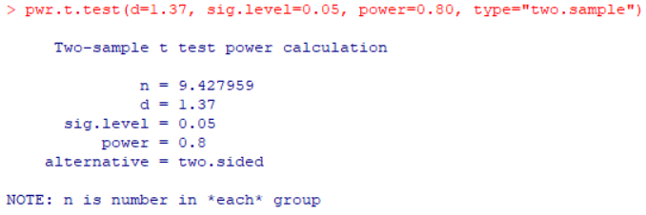
You are interested in determining if the average daily caloric intake different between men and women. You collected trial data and found the average caloric intake for males to be 2350.2 (SD=258), while females had intake of 1872.4 (SD=420).
Effect size = (Mean_{H1}-Mean_{H0})/ SD_{pooled} =(2350.2-1872.4)/ √((258²+ 420²)/2) = 477.8/348.54 = 1.37

Slide 21
You are interested in determining if the average protein level in blood different between men and women. You collected the following trial data on protein level (grams/deciliter).
Effect size = (Mean_{H1}-Mean_{H0})/ SD_{pooled} =(4.59-4.98)/ √((2.58²+ 2.88²)/2) = -0.14

Slide 22
PAIRED T-TEST
This tests if a mean from one group is different from the mean of another group, where the groups are dependent (not independent) for a normally distributed variable. Pairing can be leaves on same branch, siblings, the same individual before and after a trial, etc.
Effect size calculation
Cohen’s D = (M₂-M₁)/SD_{pooled}
M₂=Mean 2
M₁=Mean 1
SD_{pooled} =Pooled standard deviation
SD_{pooled}=√((SD₁²+ SD₂²)/2)
For t-tests; 0.2=small, 0.5=medium, and 0.8 large effect sizes

Slide 23
EXERCISES:
Calculate the sample size for the following scenarios (with α=0.05, and power=0.80):

Slide 25
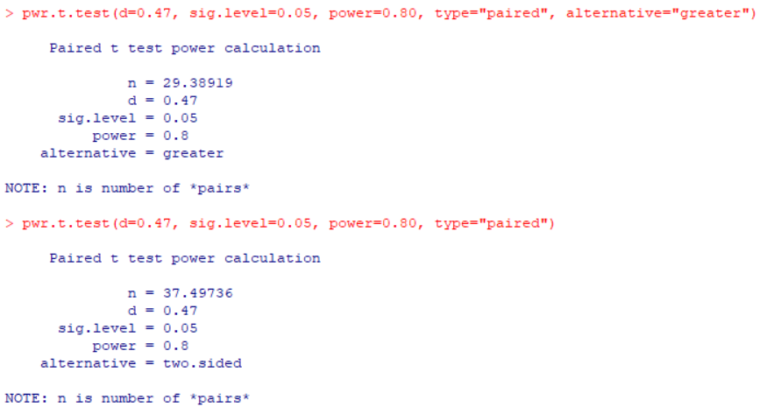
You are interested in determining if heart rate is higher in patients after a doctor’s visit compared to before a visit. You collected the following trial data and found mean heart rate before and after a visit.
Effect size = (Mean_{H1}-Mean_{H0})/ SD_{pooled} =(98.1-85.4)/ √((26.8²+ 27.2²)/2) =12.7/27 = 0.47

Slide 26
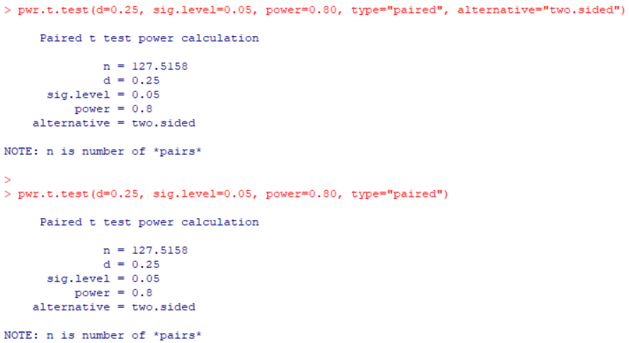
You are interested in determining if metabolic rate in patients after surgery is different from before surgery. You collected trial data and found a mean difference of 0.73 (SD=2.9).
Effect size = (Mean_{H1}-Mean_{H0})/ SD =(0.73)/ 2.9 = 0.25

Slide 27
ANALYSIS OF VARYANS (ANOVA)
For a one-way analysis of variance use
pwr.anova.test(k = , n = , f = , sig.level = , power = )
where k is the number of groups and n is the common sample size in each group.
k=Number of Groups
f=Effect Size
sig.level=Significant Level
power=Power of Test

Slide 28
For a one-way ANOVA effect size is measured by f where

Slide 29
EXERCISES:
Calculate the sample size for the following scenarios (with α=0.05, and power=0.80):

Slide 30
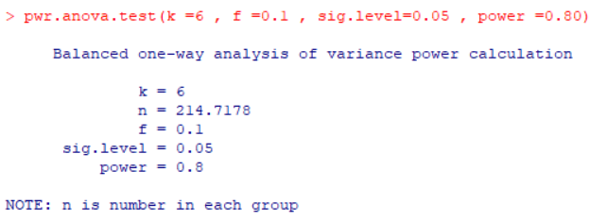

Slide 31
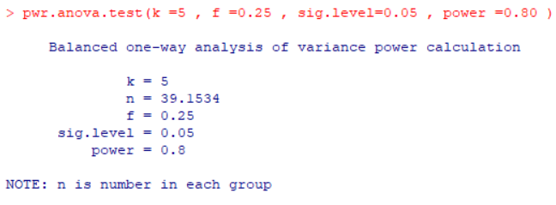
You are interested in determining if there is a difference in white blood cell counts between 5 different medication regimes. Guessed a medium effect size (0.25) and 5 groups
n = 39.15 -> 40 samples per group (200 total)

Slide 32
POWER OF COMPARISONS OF PROPORTIONS
Suppose you wish to compare the morbidity between two populations and have to decide the number of persons to sample from each population. That is, you plan to perform a comparison of two binomial distributions as described in previous using prop.test or chisq.test.

Slide 33
When comparing two proportions use
pwr.2p.test(h = , n = , sig.level =, power = )

Slide 34
where h is the effect size and n is the common sample size in each group.

Slide 35
EXERCISES:
Calculate the sample size for the following scenarios (with α=0.05, and power=0.80):

Slide 37
You are interested in determining if the expected proportion (P1) of students passing a stats course taught by psychology teachers is different than the observed proportion (P2) of students passing the same stats class taught by biology teachers. You collected the following data of passed tests.
P1=7/10=0.70, P2=6/10=0.60
h= 2*asin(sqrt(0.60))-2*asin(sqrt(0.70))=-0.21

Slide 38
You are interested in determining of the expected proportion (P1) of female students who selected YES on a question was higher than the observed proportion (P2) of male students who selected YES. The observed proportion of males who selected yes was 0.75.
Guess that the expected proportion (P1) =0.85
h= 2*asin(sqrt(0.85))-2*asin(sqrt(0.75))=0.25

Slide 39
CHI-SQUARED TEST
Extension of proportions test, which asks if table of observed values are any different from a table of expected ones. Also called Goodness-of-fit test.
For w-tests:
0.1=small,
0.3=medium, and 0.5 large effect sizes

Slide 40
EXERCISES:
Calculate the sample size for the following scenarios (with α=0.05, and power=0.80):

Slide 41
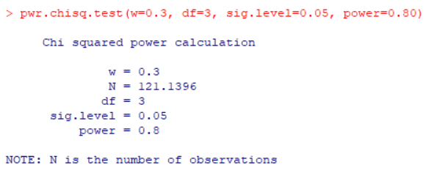

Slide 42
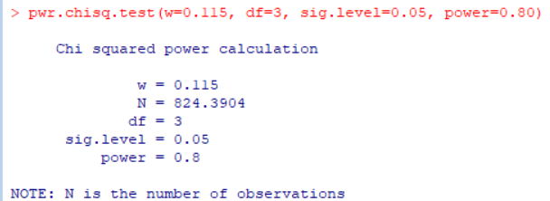
You are interested in determining if the ethnic ratios in a hospital differ by gender. You collect the following trial data from 200 employees.
Χ² (Chi-squared)= ∑(O-E)^{2/}E = (60-62.5)²/62.5 + (25-23)²/23 + (1-6)²/6 + (14-8.5)²/8.5=0.10 + 0.17 + 4.17 + 3.56 = 8
w = √(Χ² /(n*df))= √(8/(200*3))=0.115

Slide 43
NON-PARAMETRIC T-TESTS
Versions of the t-tests for non-parametric data.
One Mean Wilcoxon: sample mean against set value
Mann-Whitney: two sample means (unpaired)
Paired Wilcoxon: two sample means (paired)
There aren’t any R packages that had useful non-parametric t-tests but suggested using the parametric + 15% approach.

Slide 44
ONE MEAN WILCOXON
#Non-parametric correction

Slide 45
MANN-WHITNEY U TEST

Slide 46
WILCOXON SIGN TEST

